Slide 1
SAP FI-SD Integration

Slide 2

Organisation Elements

Slide 3
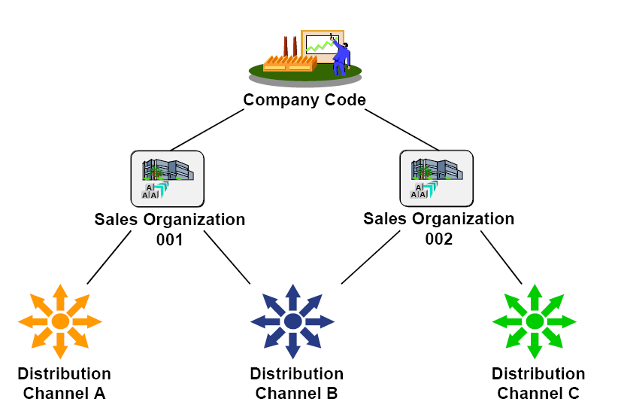
Organisation Elements

Slide 4
Organisation Elements
Sales Organisation
  Sales Organization controls the terms of sale to the customer
  Each sales organization represents a selling unit as a legal entity
  A sales organization is assigned to exactly one company code.
  A sales organization is assigned to one or more plants. Each sales organization has its own master data, for example, its own customer and material master data as well as condition records.
Distribution channel
  Distribution Channel is the element that describes through what channel goods and/or services will be distributed to the customer
Division
  Broad product range can be divided into divisions. Customer-specific agreements for each division can be maintained

Slide 5
Master Data Objects

Slide 6
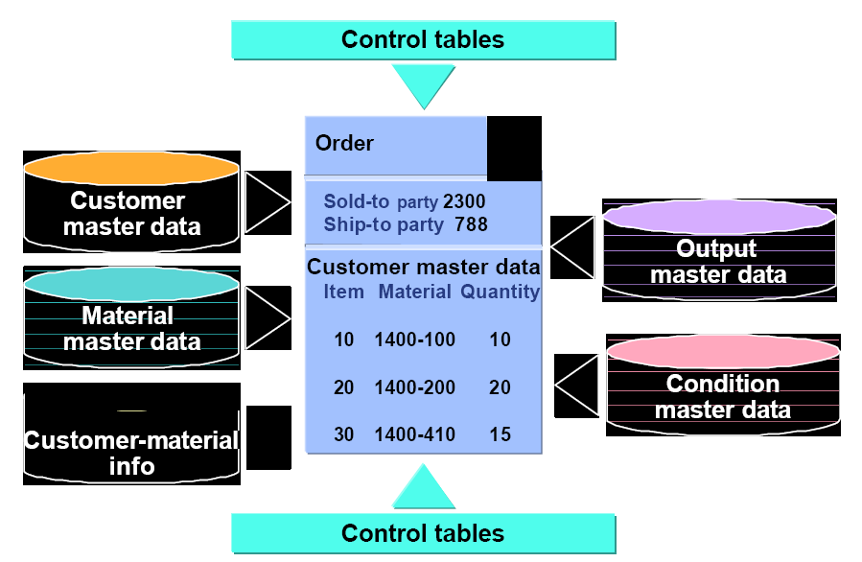
Master Data Elements

Slide 7
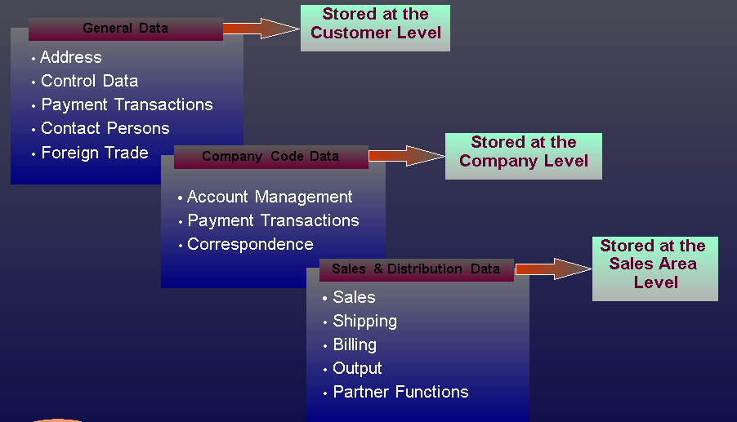
Customer master data overview

Slide 8
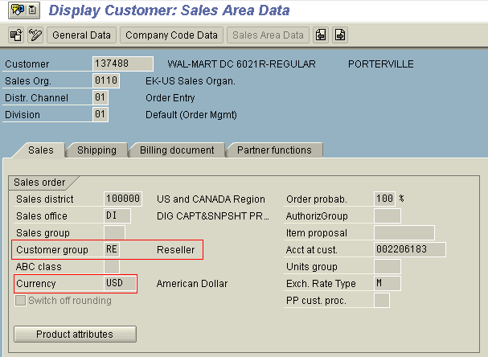
Customer master data overview
Sales View

Slide 9
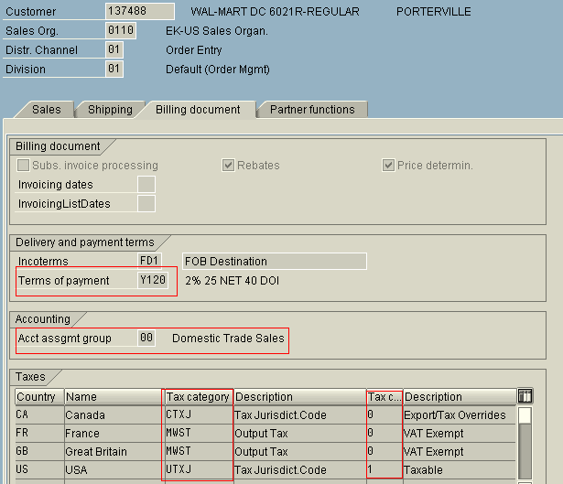
Customer master data in Sales org.
Billing document view

Slide 10
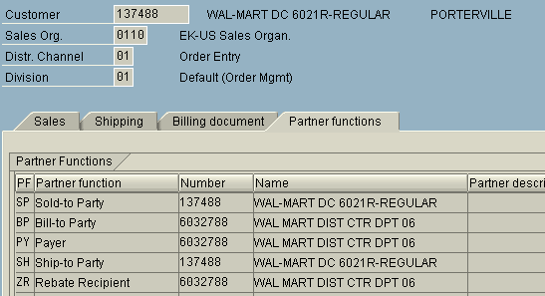
Customer master data in Sales org.
Partner functions view

Slide 11
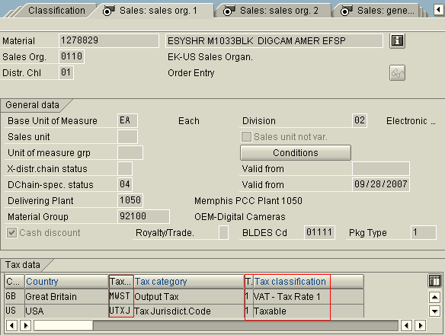
Material Master data in Sales org.
Sales Org.1 View

Slide 12
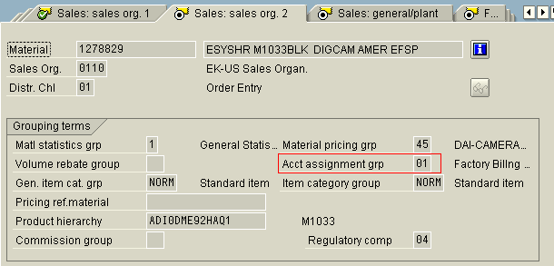
Material Master data in Sales org.
Sales Org. 2 View

Slide 13
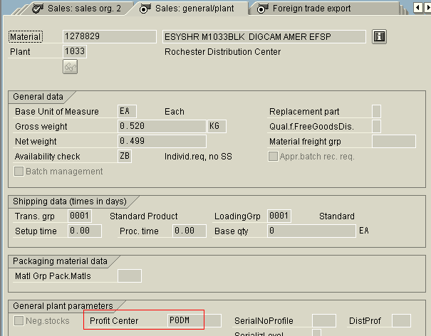
Material Master data in Sales org.
General View

Slide 14
Sales Process Overview

Slide 15
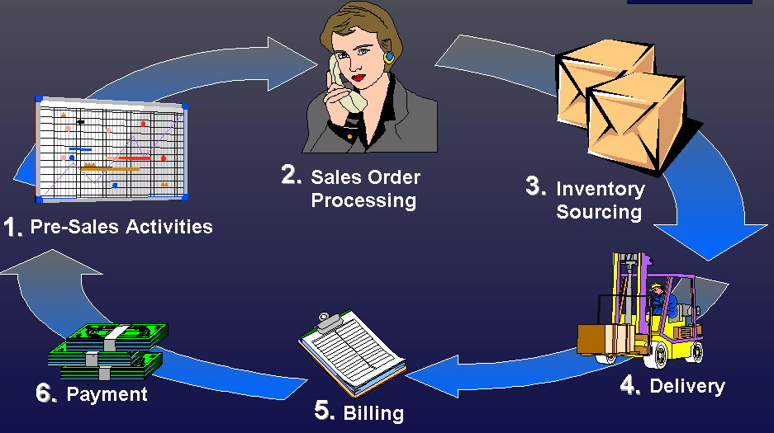
Sales Process Overview

Slide 16
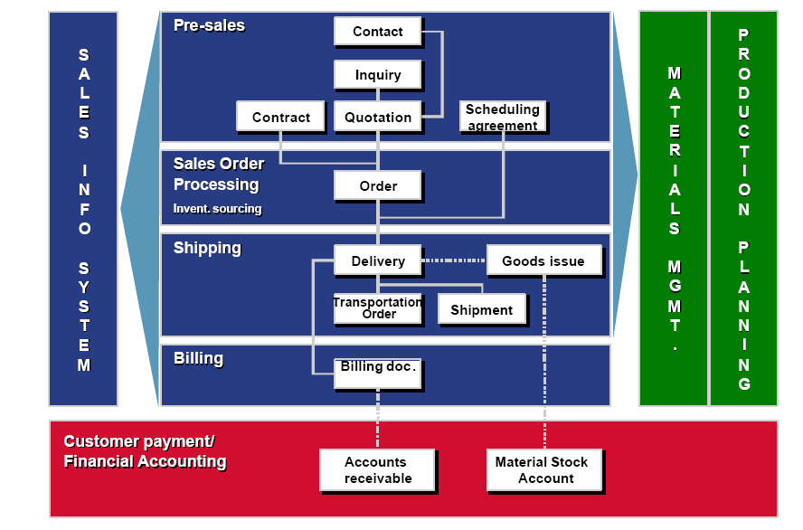
Activities involved in sales process

Slide 17
Sales process- Order processing
Sales order processing
  Customer information
  Product information
  Pricing information
  Delivery information
  Billing information

Slide 18
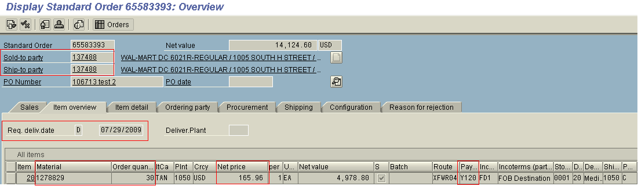
Sales process- Order processing
Sales order – Line Item data

Slide 19
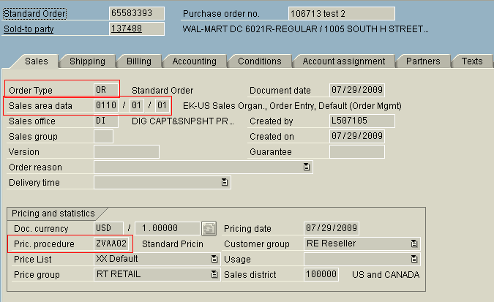
Sales process- Order processing
Sales Order – Header data

Slide 20
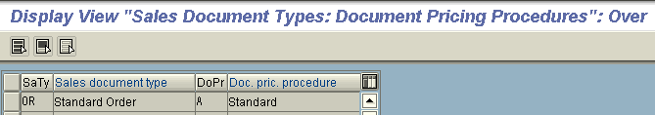
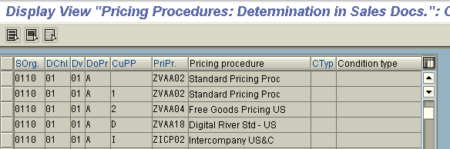
Sales process- Order processing
Sales order type pricing procedure
Pricing procedure assignment

Slide 21
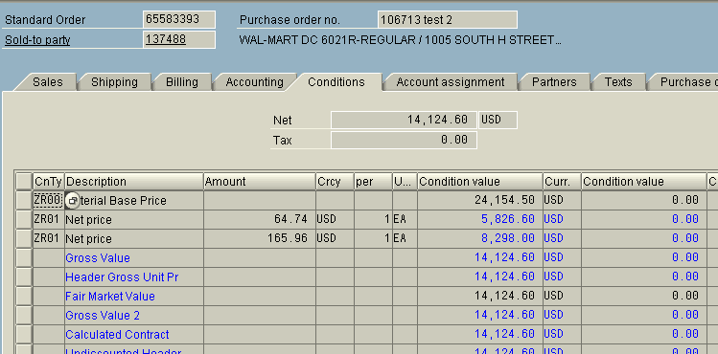
Sales process- Order processing
Sales Order Valuation

Slide 22
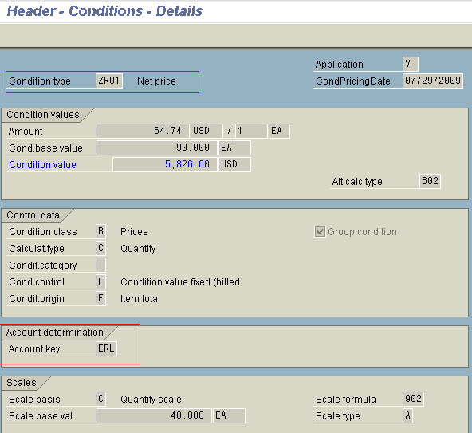
Sales process- Order processing
Sales Order – Condition type

Slide 23
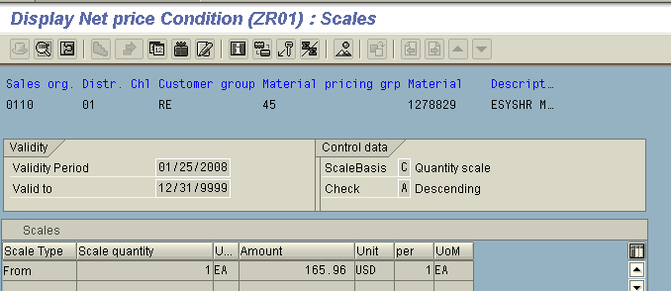
Sales process- Order processing
Sales Order – Condition record

Slide 24
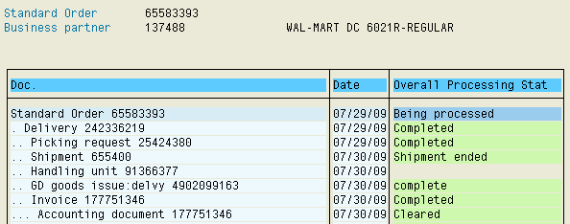
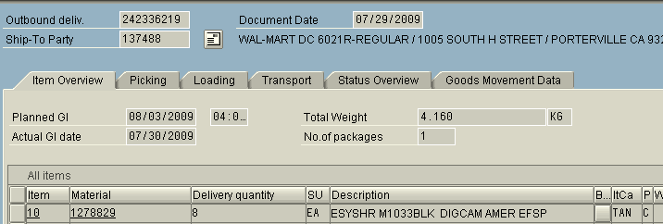
Sales process- Order processing
Sales order Document view
Sales order delivery document

Slide 25
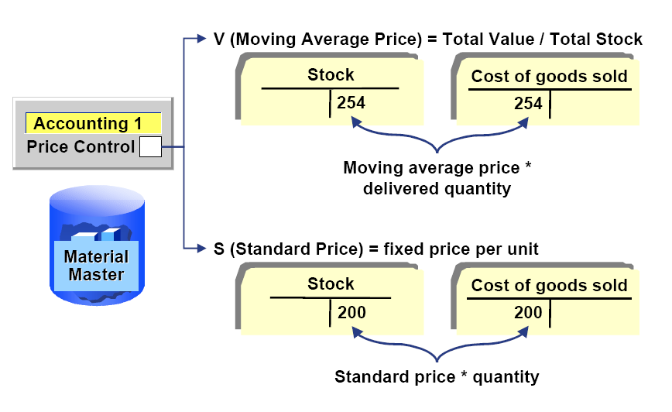
Sales process- Order processing
Stock valuation in delivery

Slide 26
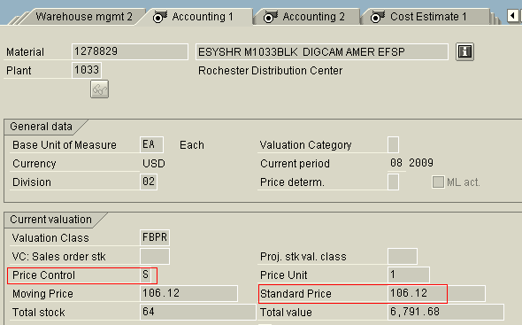
Sales process- Order processing
Material Master - Accounting View

Slide 27
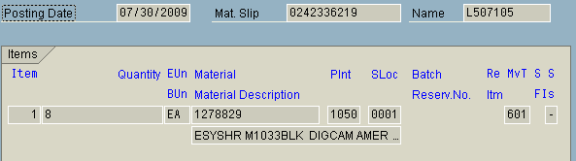
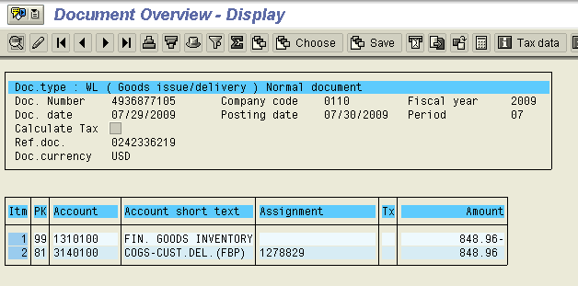
Sales process- Order processing
Delivery - Material Document
Delivery – Financial Document

Slide 28

Sales process- Billing & Payment
Billing
  Invoice preparation
Payment
  Receiving and recording payment
Dr Customer A/c
Cr Sales Revenue A/c
Dr Cash/Bank A/c
Cr Customer A/c

Slide 29
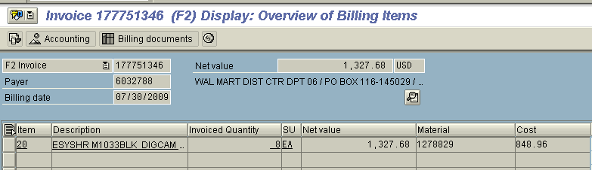
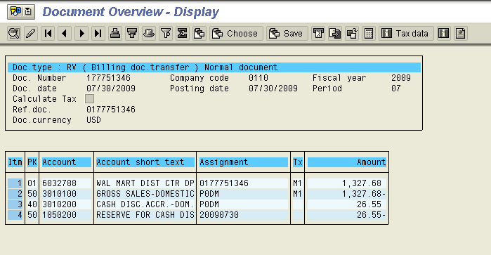
Sales process- Billing
Invoice - Sales Document
Invoice - Financial Document

Slide 30
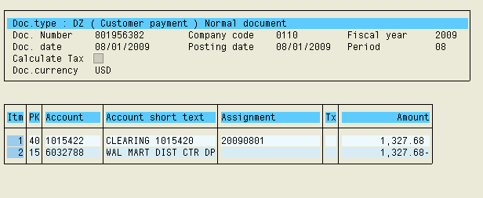
Sales process- customer Payment
Payment document

Slide 31
Account determination process

Slide 32
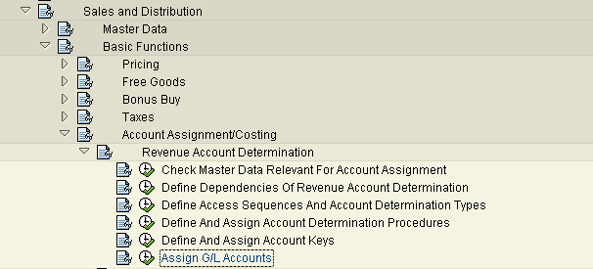
Account Determination Process
Menu path for account determination

Slide 33
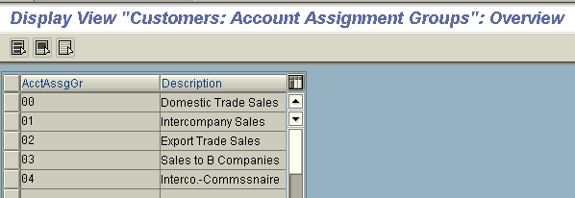
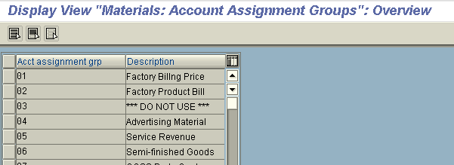
Account Determination Process
Check Master Data Relevant For Acc. Assnt.
  Customer
  Material

Slide 34
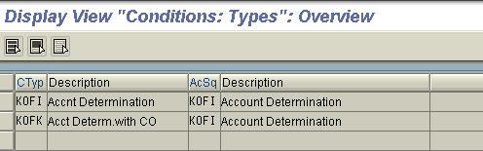
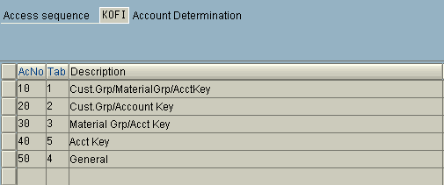
Account Determination Process
Access Sequences And Account Determination Type
  Account determination types
  Maintain access sequences

Slide 35
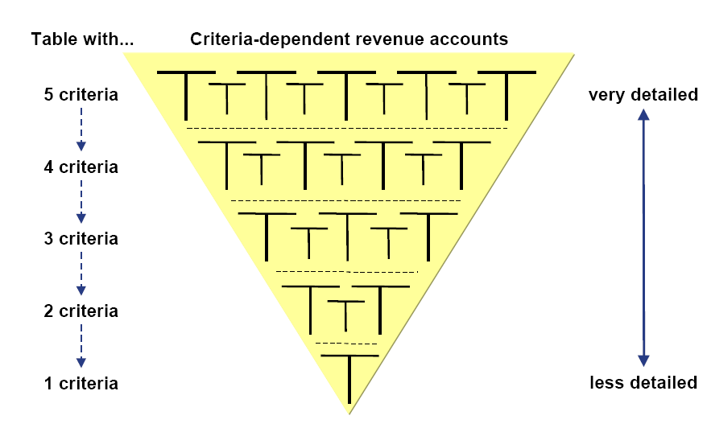
Account Determination Process

Slide 36
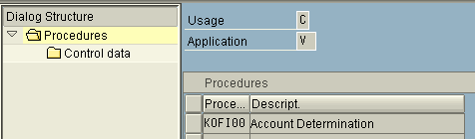
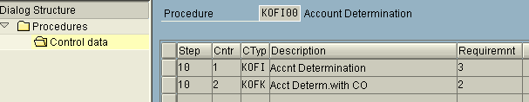
Account Determination Process
Define Account Determination Procedures
  Define
  Condition

Slide 37
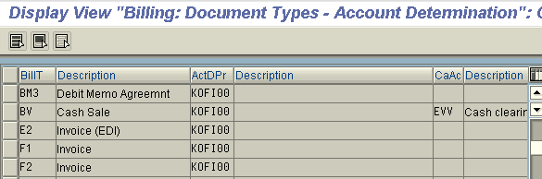
Account Determination Process
Assign Account Determination Procedure to billing type

Slide 38
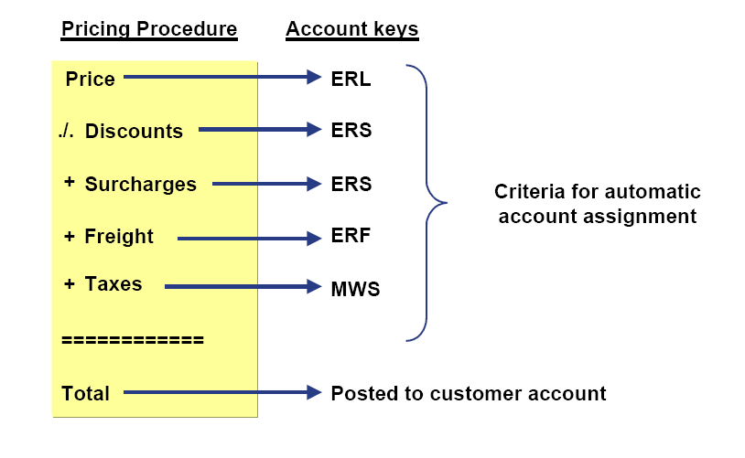
Account Determination Process
Account Keys

Slide 39
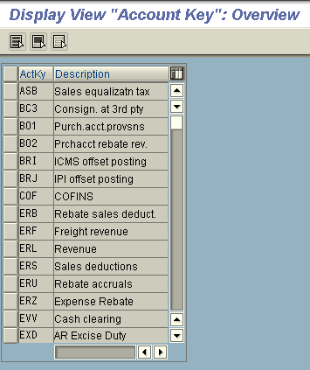
Account Determination Process
Define account key

Slide 40
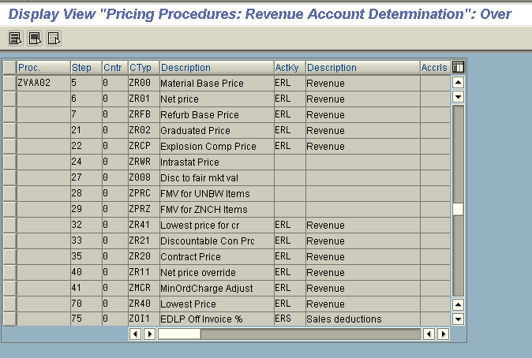
Account Determination Process
Pricing procedure Account key assignment

Slide 41
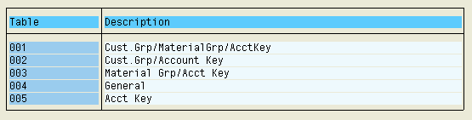
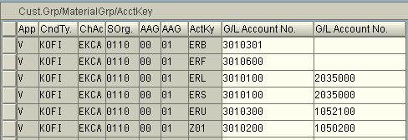
Account Determination Process
Assign G/L Accounts
001 Cust.Grp/MaterialGrp/AcctKey

Slide 42
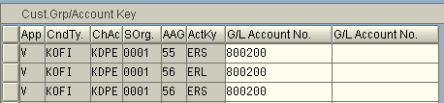
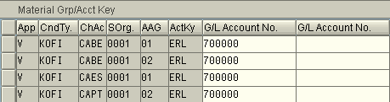
Account Determination Process
002 Cust.Grp/Account Key
003 Material Grp/Acct Key

Slide 43
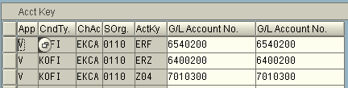

Account Determination Process
005 Acct Key
004 General

Slide 44
Thank You!

